Slide 1
Evaluating NLP Methods Within the OHDSI Framework
A Preliminary Approach from the NLP WG
Daniel Smith, Marta Alvarez, Michael Gurley, Vipina Keloth, Andrew Williams, and Kyle Zollo-Venecek

Slide 2
Evaluating NLP Methods Within the OHDSI Framework
A Preliminary Approach
Daniel Smith, Kyle X, Andrew Williams, Michael Gurley, Marta X, and Vipina Keloth

Slide 3
Information Extraction Tasks
Evaluation Target: NLP Methods
Evaluation Context: OHDSI Network
Evaluating
NLP
Methods
Within
the
OHDSI
Framework
(VP)
(NP)
[Evaluation Target]
(Preposition)
(NP)
[Evaluation Context]

Slide 4
Evaluation Context: OHDSI Network
Our Mission
To improve health by empowering a community to collaboratively generate the evidence that promotes better health decisions and better care.
Our Vision
A world in which observational research produces a comprehensive understanding of health and disease.
Our Values
Innovation: Observational research is a field which will benefit greatly from disruptive thinking. We actively seek and encourage fresh methodological approaches in our work.
Reproducibility: Accurate, reproducible, and well-calibrated evidence is necessary for health improvement.
Community: Everyone is welcome to actively participate in OHDSI, whether you are a patient, a health professional, a researcher, or someone who simply believes in our cause.
Collaboration: We work collectively to prioritize and address the real world needs of our community’s participants.
Openness: We strive to make all our community’s proceeds open and publicly accessible, including the methods, tools and the evidence that we generate.
Beneficence: We seek to protect the rights of individuals and organizations within our community at all times.

Slide 5
Evaluation Context: OHDSI Network
Our Mission
To improve health by empowering a community to collaboratively generate the evidence that promotes better health decisions and better care.
Our Vision
A world in which observational research produces a comprehensive understanding of health and disease.
Our Values
Innovation: Observational research is a field which will benefit greatly from disruptive thinking. We actively seek and encourage fresh methodological approaches in our work.
Reproducibility: Accurate, reproducible, and well-calibrated evidence is necessary for health improvement.
Community: Everyone is welcome to actively participate in OHDSI, whether you are a patient, a health professional, a researcher, or someone who simply believes in our cause.
Collaboration: We work collectively to prioritize and address the real world needs of our community’s participants.
Openness: We strive to make all our community’s proceeds open and publicly accessible, including the methods, tools and the evidence that we generate.
Beneficence: We seek to protect the rights of individuals and organizations within our community at all times.

Slide 6
Evaluation Context: OHDSI Network
Why do we care?

Slide 7
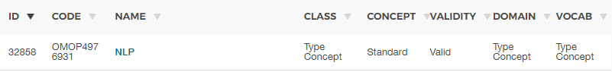
Evaluation Context: OHDSI Network
Why do we care?
NLP is being increasingly used to provide information from unstructured text that would otherwise not be available
The OHDSI Network may soon start seeing more of this:
NLP working group is proposing pushing NLP data right into the tables (NOTE_NLP -> CONDITION_OCCURRENCE)
Mike’s Presentation at earlier today

Slide 8
Evaluation Context: OHDSI Network
Our Mission
To improve health by empowering a community to collaboratively generate the evidence that promotes better health decisions and better care.
Our Vision
A world in which observational research produces a comprehensive understanding of health and disease.
Our Values
Innovation: Observational research is a field which will benefit greatly from disruptive thinking. We actively seek and encourage fresh methodological approaches in our work.
Reproducibility: Accurate, reproducible, and well-calibrated evidence is necessary for health improvement.
Community: Everyone is welcome to actively participate in OHDSI, whether you are a patient, a health professional, a researcher, or someone who simply believes in our cause.
Collaboration: We work collectively to prioritize and address the real world needs of our community’s participants.
Openness: We strive to make all our community’s proceeds open and publicly accessible, including the methods, tools and the evidence that we generate.
Beneficence: We seek to protect the rights of individuals and organizations within our community at all times.

Slide 9

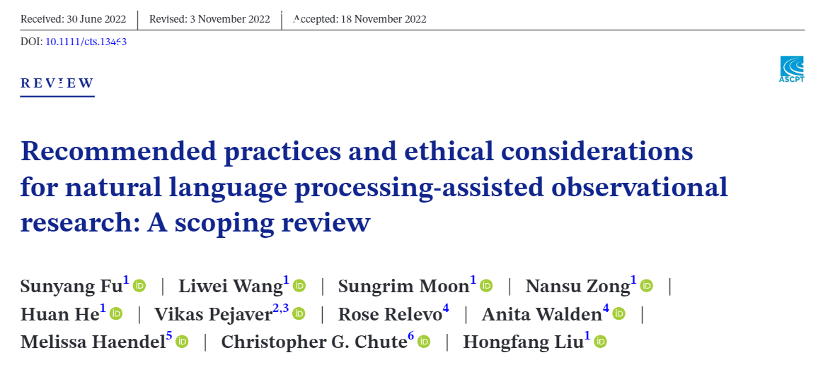
Reproducibility and Openness
https://doi.org/10.1111/cts.13463

Slide 10
Reproducibility and Openness
Key Findings (Fu et al., 2022)
Scoped studies (50) demonstrated:
22%: No reported design of evaluation
10%: No report of NLP methodology
14%: Neither of the above
82%: No reported reference to measurement study
Implications:
48%: Data elements = Risk Factors
42%: Data elements = Health Outcomes
100%: Problem if NLP Methods are Invalid!*
* = Statistic not included in original
https://doi.org/10.1111/cts.13463

Slide 11
Evaluation Context: OHDSI Network
Why do we care?
NLP is being increasingly used to provide information from unstructured text that would otherwise not be available
The OHDSI Network may soon start seeing more of this:
Implications:
48%: Data elements = Risk Factors
42%: Data elements = Health Outcomes
100%: Problem if NLP Methods are Invalid!*
What are we going to do?
Fu and colleagues ALSO propose a solution for the NLP community

Slide 12
Evaluation Context: OHDSI Network
Findability, Accessibility, Interoperability, and Reusability
Reproducible, Implementable, Transparent, and Explainable
What are we going to do?
Fu and colleagues ALSO propose a solution for the NLP community
Grounded in FAIR and RITE principles

Slide 13
NLP Methodology Evaluation
Inspired by Fu and colleagues (2022)

Slide 14
Example NLP Method for Reference
MedSpacy (https://github.com/medspacy/medspacy)
Documents in Source
Pre-processing
Named Entity Recognition
Normalization
NOTE_NLP Table
Clinical event table

Slide 15
NLP Methodology Evaluation
Example NLP Method for Reference
MedSpacy (https://github.com/medspacy/medspacy)
Documents in Source
Pre-processing
Named Entity Recognition
Normalization
NOTE_NLP Table
Clinical event table

Slide 16
NLP Methodology Evaluation
Category | Evaluation | Source
Overall Recommendations | Conduting measurement/evaluation study prior to deployment in observational research designed to answer clinical questions. | O
 | If measurement study disseminated: 1) provide reference; 2) provide evaluation and methods | M
 | If measurement study NOT disseminated: 1) report evaluation and methods with enough information to allow replication, 2) provide a summary of full NLP pipeline | M
Evaluation study Report
Documents in Source
Pre-processing
Named Entity Recognition
Normalization
NOTE_NLP Table
Clinical event table

Slide 17
NLP Methodology Evaluation
Category | Evaluation | Source
Study Environment, data source, cohort | Potential variability between evaluation environment and application environment | O
 | Detailed cohort definition (i.e., participant selection) | O
 | Detailed methods for constructing cohort (i.e., database search methods) | O
 | Cohort screening procedures | O
 | Validity assessment of cohort screening procedures | O
Evaluation study Report
Documents in Source
Pre-processing
Named Entity Recognition
Normalization
NOTE_NLP Table
Clinical event table
Study env, source, cohort

Slide 18
NLP Methodology Evaluation
Category | Evaluation | Source
Corpus Annotation | Annotators that are subject matter experts | O
 | Appropriate annotator number, with minimum of 2 | O
 | Size of corpus annotation | O
 | greement score computation method and minimum required (e.g., Kappa, F-1) | O
Evaluation study Report
Validation
Documents in Source
Pre-processing
Named Entity Recognition
Normalization
NOTE_NLP Table
Clinical event table
Study env, source, cohort
Corpus Annotation

Slide 19
NLP Methodology Evaluation
Category | Evaluation | Source
NLP Algorithm and Framework Definition | Context definitions for: term certainty(negation, hypothetical, possible) status (past, present, future) experiencer (patient, family) | O
 | Normalization techniques and resources | O
 | Rule-based lexicons, including patterns and logic | M
 | Code access to all components of pipeline (e.g., generic text processors, statistical models), including specific commit | M
MedSpacy (https://github.com/medspacy/medspacy)
MedSpacy (de523ds8z) (https://github.com/medspacy/medspacy)
Evaluation study Report
Commit of Components
Techniques and resources
Validation
Documents in Source
Pre-processing
Named Entity Recognition
Normalization
NOTE_NLP Table
Clinical event table
Study env, source, cohort
Corpus Annotation
Rules
Context Definitions

Slide 20
NLP Methodology Evaluation
Category | Evaluation | Source
NLP Evaluation and Refinement | Measurement level of evaluation (concept/document/patient) | O
 | Duration of NLP Evaluation | O
 | Application vs. Evaluation environment assessment | O
 | Process used to refine system based on error analyses | O
Evaluation study Report
Commit of Components
Techniques and resources
Validation
Documents in Source
Pre-processing
Named Entity Recognition
Normalization
NOTE_NLP Table
Clinical event table
Study env, source, cohort
Corpus Annotation
Rules
Context Definitions
Evaluation and Refinement

Slide 21
NLP Methodology Evaluation
Evaluation study Report
Commit of Components
Techniques and resources
Validation
Documents in Source
Pre-processing
Named Entity Recognition
Normalization
NOTE_NLP Table
Clinical event table
Study env, source, cohort
Corpus Annotation
Rules
Context Definitions
Evaluation and Refinement

Slide 22
Documenting the Evaluation
Inspired by Fu and colleagues (2022)

Slide 23
Documenting the Evaluation
Findability, Accessibility, Interoperability, and Reusability
Reproducible, Implementable, Transparent, and Explainable
Proposal
Github via CFF
Evaluation study Report
Commit of Components
Techniques and resources
Validation
Documents in Source
Pre-processing
Named Entity Recognition
Normalization
NOTE_NLP Table
Clinical event table
Study env, source, cohort
Corpus Annotation
Rules
Context Definitions
Evaluation and Refinement

Slide 24
Documenting the Evaluation
Findability, Accessibility, Interoperability, and Reusability
Reproducible, Implementable, Transparent, and Explainable
Proposal
Github via CFF
Evaluation study Report
Commit of Components
Techniques and resources
Validation
Documents in Source
Pre-processing
Named Entity Recognition
Normalization
NOTE_NLP Table
Clinical event table
Study env, source, cohort
Corpus Annotation
Rules
Context Definitions
Evaluation and Refinement

Slide 25
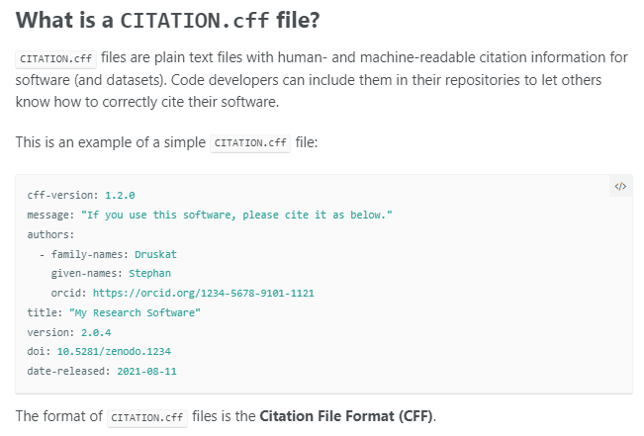
Documenting the Evaluation
https://docs.github.com/en/repositories/managing-your-repositorys-settings-and-features/customizing-your-repository/about-citation-files

Slide 26
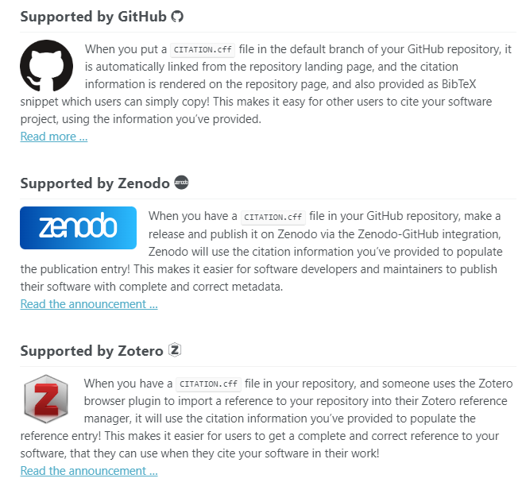
Documenting the Evaluation
https://docs.github.com/en/repositories/managing-your-repositorys-settings-and-features/customizing-your-repository/about-citation-files

Slide 27
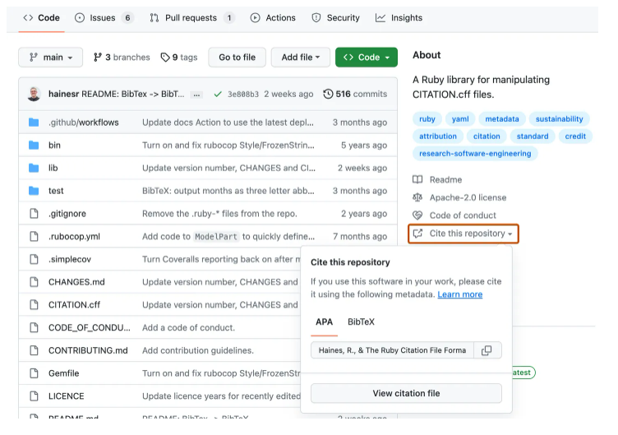
Documenting the Evaluation
https://docs.github.com/en/repositories/managing-your-repositorys-settings-and-features/customizing-your-repository/about-citation-files

Slide 28
Documenting the Evaluation
Findability, Accessibility, Interoperability, and Reusability
Reproducible, Implementable, Transparent, and Explainable
Proposal
Github via CFF
In OMOP
Evaluation study Report
Commit of Components
Techniques and resources
Validation
Documents in Source
Pre-processing
Named Entity Recognition
Normalization
NOTE_NLP Table
Clinical event table
Study env, source, cohort
Corpus Annotation
Rules
Context Definitions
Evaluation and Refinement

Slide 29
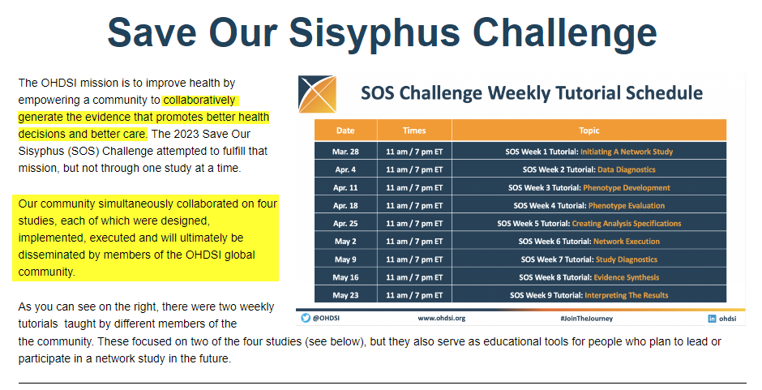
Documenting the Evaluation
Week 1: Initiating a Network Study
Database
Paper
https://ohdsi.org/sos-challenge/

Slide 30
Documenting the Evaluation
Week 5: Analysis Design
Data Quality
Phenotype Development
Analysis reliability
Final unblinded results
Interface for Exploration
Paper
CFF?
fact_relationship
metadata
Evaluation study Report
Commit of Components
Techniques and resources
Validation
Documents in Source
Pre-processing
Named Entity Recognition
Normalization
NOTE_NLP Table
Clinical event table
Study env, source, cohort
Corpus Annotation
Rules
Context Definitions
Evaluation and Refinement
https://ohdsi.org/sos-challenge/

Slide 31
Documenting the Evaluation
Findability, Accessibility, Interoperability, and Reusability
Reproducible, Implementable, Transparent, and Explainable
Proposal
Github via CFF
In OMOP
Scoring system for easy communication between sites
Evaluation study Report
Commit of Components
Techniques and resources
Validation
Documents in Source
Pre-processing
Named Entity Recognition
Normalization
NOTE_NLP Table
Clinical event table
Study env, source, cohort
Corpus Annotation
Rules
Context Definitions
Evaluation and Refinement

Slide 32
Documenting the Evaluation
Category | Evaluation | Source | Score
Overall Recommendations | Conduting measurement/evaluation study prior to deployment in observational research designed to answer clinical questions. | M | 1
 | If measurement study disseminated: 1) provide reference; 2) provide evaluation and methods | M | 1
 | If measurement study NOT disseminated: 1) report evaluation and methods with enough information to allow replication, 2) provide a summary of full NLP pipeline | M | 1
Study Environment, data source, cohort | Potential variability between evaluation environment and application environment | O | 1
 | Detailed cohort definition (i.e., participant selection) | O | 1
 | Detailed methods for constructing cohort (i.e., database search methods) | O | 1
 | Cohort screening procedures | O | 1
 | Validity assessment of cohort screening procedures | O | 1
Corpus Annotation | Annotators that are subject matter experts | O | 1
 | Appropriate annotator number, with minimum of 2 | O | 1
 | Size of coprus annotation | O | 1
 | Agreement score computation method and minimum required (e.g., Kappa, F-1) | O | 1
NLP Algorithm and Framework Definition | Context definitions for: 1) term certainty(negation, hypothetical, possible), 2) status (past, present, future), 3) experiencer (patient, family) | O | 1
 | Normalization techniques and resources | O | 1
 | Rule-based lexicons, including patterns and logic | M | 1
 | Code access to all components of pipeline (e.g., generic text processors, statistical models) | M | 1
NLP Evaluation and Refinement | Measurement level of evaluation (concept/document/patient) | O | 1
 | Duration of NLP Evaluation | O | 1
 | Application vs. Evaluation environment assessment | O | 1
 | Process used to refine system based on error analyses | O | 1

Slide 33
Documenting the Evaluation
Category | Evaluation | Source | Score
Overall Recommendations | Conduting measurement/evaluation study prior to deployment in observational research designed to answer clinical questions. | M | 1
 | If measurement study disseminated: 1) provide reference; 2) provide evaluation and methods | M | 1
 | If measurement study NOT disseminated: 1) report evaluation and methods with enough information to allow replication, 2) provide a summary of full NLP pipeline | M | 1
Study Environment, data source, cohort | Potential variability between evaluation environment and application environment | O | 1
 | Detailed cohort definition (i.e., participant selection) | O | 1
 | Detailed methods for constructing cohort (i.e., database search methods) | O | 1
 | Cohort screening procedures | O | 1
 | Validity assessment of cohort screening procedures | O | 1
Corpus Annotation | Annotators that are subject matter experts | O | 1
 | Appropriate annotator number, with minimum of 2 | O | 1
 | Size of coprus annotation | O | 1
 | Agreement score computation method and minimum required (e.g., Kappa, F-1) | O | 1
NLP Algorithm and Framework Definition | Context definitions for: 1) term certainty(negation, hypothetical, possible), 2) status (past, present, future), 3) experiencer (patient, family) | O | 1
 | Normalization techniques and resources | O | 1
 | Rule-based lexicons, including patterns and logic | M | 1
 | Code access to all components of pipeline (e.g., generic text processors, statistical models) | M | 1
NLP Evaluation and Refinement | Measurement level of evaluation (concept/document/patient) | O | 1
 | Duration of NLP Evaluation | O | 1
 | Application vs. Evaluation environment assessment | O | 1
 | Process used to refine system based on error analyses | O | 1
Scoring System
Bronze = 7 points
Silver = 11
Gold = 15
Platinum = 20

Slide 34
Documenting the Evaluation
Data Quality
Phenotype Development
Analysis reliability
Final unblinded results
Interface for Exploration
Paper
CFF
fact_relationship
metadata
Evaluation study Report
Commit of Components
Techniques and resources
Validation
Documents in Source
Pre-processing
Named Entity Recognition
Normalization
NOTE_NLP Table
Clinical event table
Study env, source, cohort
Corpus Annotation
Rules
Context Definitions
Evaluation and Refinement

